Slide 1
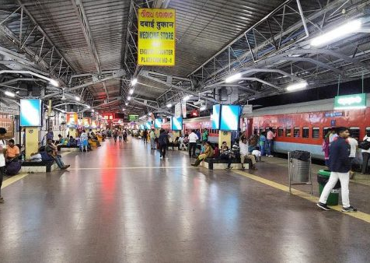
RAIWAY RESERVATION SYSTEM
GROUP-6

Slide 2
TEAM MEMBERS
SL No. | MEMBERS NAME | REGISTRATION NUMBER
1 | VINAY PRABHAKAR | 2201020148
2 | SUNNY KUMAR | 2201020423
3 | PRIYANSHU KUMAR BHADANI | 2201020565
4 | KUNAL CHIRANIA | 2201020698
5 | VIVEK KUMAR | 2201020767

Slide 3
INTRODUCTION
In Railway Reservation System we are perform different tasks. we are going to collect all data of passenger and about the train .Firstly user have to choose which class and where he/she want to travel. After that user have to provide the date when will passenger want the Railway ticket and when will passenger return also after getting the data from passenger we check the Train is available or not. If Train is not available then we are going to print Train is unavailable and calculate the rent as per the data chart.

Slide 4
CONTENT
.
WHY DO WE NEED A RAILWAY RESERVATION SYSTEM?
BENEFITS OF RAILWAY RESERVATION SYSTEM
COMPONENTS OF RAILWAY RESERVATION SYSTEM
CHALLENGES FACED AND THEIR SOLUTIONS
FUTURE OF RAILWAY RESERVATION SYSTEM
CONCLUSION

Slide 5
WHY DO WE NEED A RAILWAY RESERVATION SYSTEM?
Seat Allocation and Planning: Ensures systematic seat allocation for optimal train capacity.
Efficient Resource Management: Advance knowledge of passenger numbers aids in effective resource planning.
Customer Convenience: Allows passengers to book tickets in advance, especially for popular routes.
Reduced Queues and Waiting Time: Online and advance booking minimizes queues and waiting times at counters.
Predictable Revenue and Financial Planning: Enables authorities to predict revenue for better financial planning.
Optimized Train Operations: Aids in scheduling, frequency planning, and optimizing overall operations.
Prevention of Overcrowding: Manages passenger numbers to prevent overcrowding, especially during peak times.
Enhanced Security and Safety: Facilitates passenger tracking for security purposes and emergencies.
Integration with Other Services: Modern systems integrate with online payment, mobile apps, and travel agencies.

Slide 6
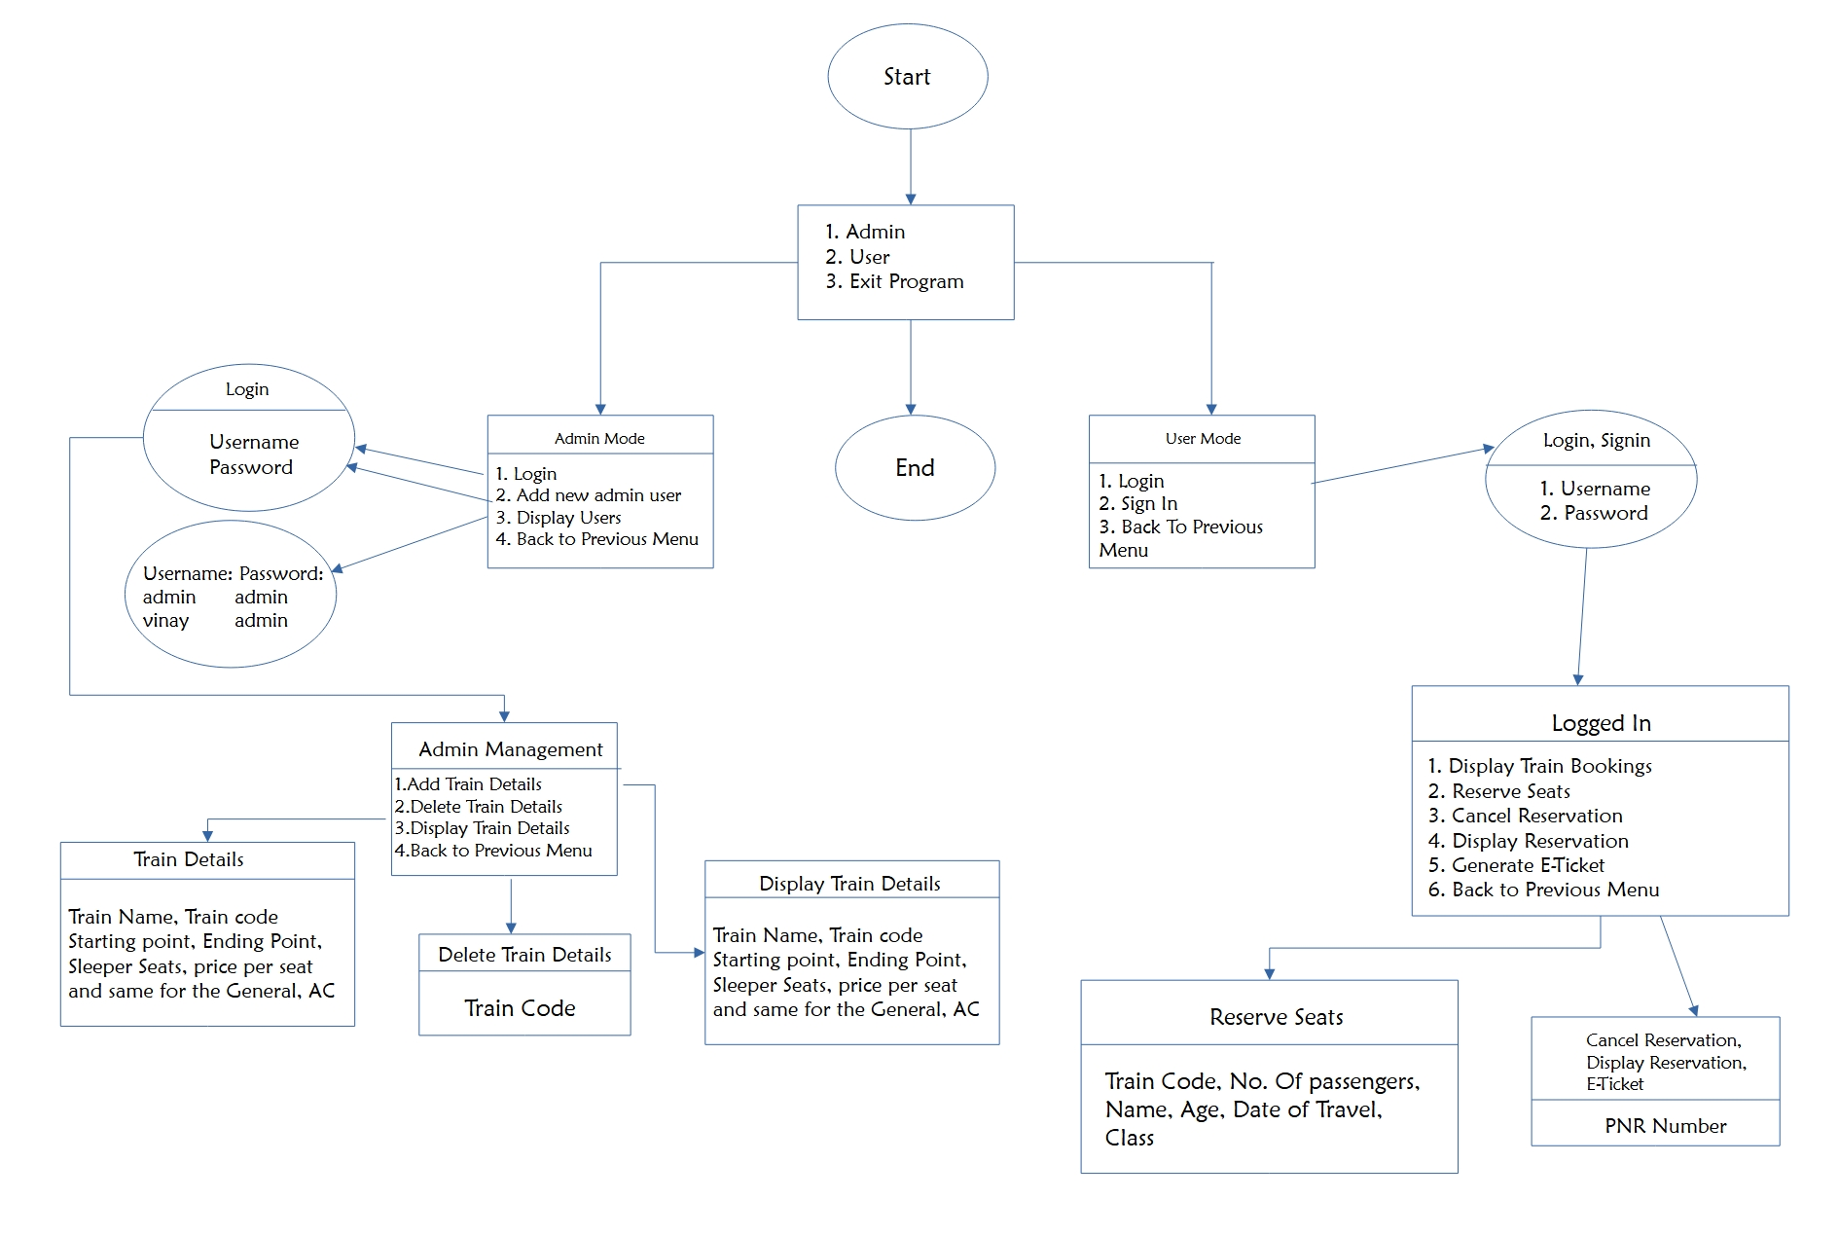
FLOW Chart of Program

Slide 7
BENEFITS OF RAILWAY RESERVATION SYSTEM
Efficiency: Streamlines the booking process for train tickets.
Avoiding Overcrowding: Allows passengers to secure seats in advance, preventing overcrowded trains.
Time-Saving: Enables quick online booking, payment, and seat availability checks.
Reducing Human Errors: Automation minimizes errors in ticketing and reservation management.
Customer Convenience: Permits passengers to book tickets from anywhere with internet access.
Optimizing Resources: Ensures efficient use of trains and overall resource management.
Improved Planning: Provides data for better train schedule management and resource allocation.
Enhanced Security: Incorporates measures to protect passenger information and financial transactions.
Adaptability to Demand: Allows adjustments in the number of available seats based on demand.
Financial Transparency: Facilitates automated billing and transaction processes for better financial management.

Slide 8
COMPONENTS OF RAILWAY RESERVATION SYSTEM
User Interface:
Booking: Search, select dates, and book tickets.
Login: Manages user accounts securely.
Payment: Enables online secure transactions.
Transaction: Records ticket transactions and payments.
2. Reservation Engine:
Seat Allocation: Determines and assigns seats.
Dynamic Pricing: Adjusts prices based on demand.
3. Availability Checker:
Real-time: Instant seat availability info.

Slide 9
COMPONENTS OF RAILWAY RESERVATION SYSTEM
4. Payment and Security Module:
Processing: Facilitates secure online transactions.
Encryption: Ensures data confidentiality.
5. Notification System:
Alerts: Sends confirmations and updates.
Special Events: Notifies about delays or cancellations.
6. Admin Panel:
Dashboard: Overview of system operations.
Management: Controls user accounts and permissions.
Reporting: Generates reports on trends and performance.
7. Cancellation and Refund:
Interface: Allows ticket cancellation.
Refund Calculation: Processes refunds based on policies.

Slide 10
CHALLENGES FACED & THEIR SOLUTIONS
Scalability:
Challenge: Handling peak booking loads.
Solution: Ensure system scalability for varying demand levels.
Data Security:
Challenge: Protecting sensitive user and payment data.
Solution: Implement robust security measures against breaches.
Integration with Existing Systems:
Challenge: Coordinating with broader railway infrastructure.
Solution: Seamless integration for accurate real-time updates.
User Experience:
Challenge: Designing an intuitive interface.
Solution: Ensure easy navigation and booking for customer satisfaction.
Dynamic Pricing Challenges:
Challenge: Balancing revenue and customer satisfaction.
Solution: Careful consideration of demand, class, and historical data.
Transaction Failures and Refunds:
Challenge: Handling failures and ensuring accurate refunds.
Solution: Streamlined process for cancellations and refunds.
Network Connectivity:
Challenge: Functioning in areas with varying connectivity.
Solution: Ensure system accessibility in remote locations.
System Downtime:
Challenge: Minimizing interruptions for users.
Solution: Schedule maintenance and updates carefully.

Slide 11
FUTURE OF RAILWAY RESERVATION SYSTEM
Digital Transformation:
Emphasis on digital channels for bookings.
Mobile apps and online platforms for services.
AI and ML:
Optimize seat allocation with AI and ML.
Predict demand and enhance pricing.
Blockchain:
Secure, transparent transactions.
Improves data integrity, prevents fraud.
IoT:
Real-time monitoring for train status.
Provides accurate information to passengers.
Enhanced Analytics:
Deeper insights into passenger behavior.
Informed decision-making.
Personalized Services:
Recommendations based on user profiles.
Tailored services and promotions.
Biometric Authentication:
Secure login with biometrics.
Reduces reliance on passwords.
AR and VR:
Virtual seat previews with AR and VR.
Visual representations of chosen seats.
Predictive Maintenance:
IoT and analytics for predictive maintenance.
Reduces downtime, enhances reliability.

Slide 12
CONCLUSION
In conclusion, a C++ railway reservation system is like a smart helper for train companies. It helps them manage things better and makes customers happy. With features like easy booking, quick availability checks, and automatic billing, it makes everything smoother. The system is safe and can grow with the company's needs. It's also user-friendly, affordable, and follows the rules. This system is like a good friend that helps the company earn more money and keeps customers smiling. And the best part? It can get even better in the future!

Slide 13
THANK YOU!!!

